Slide 1
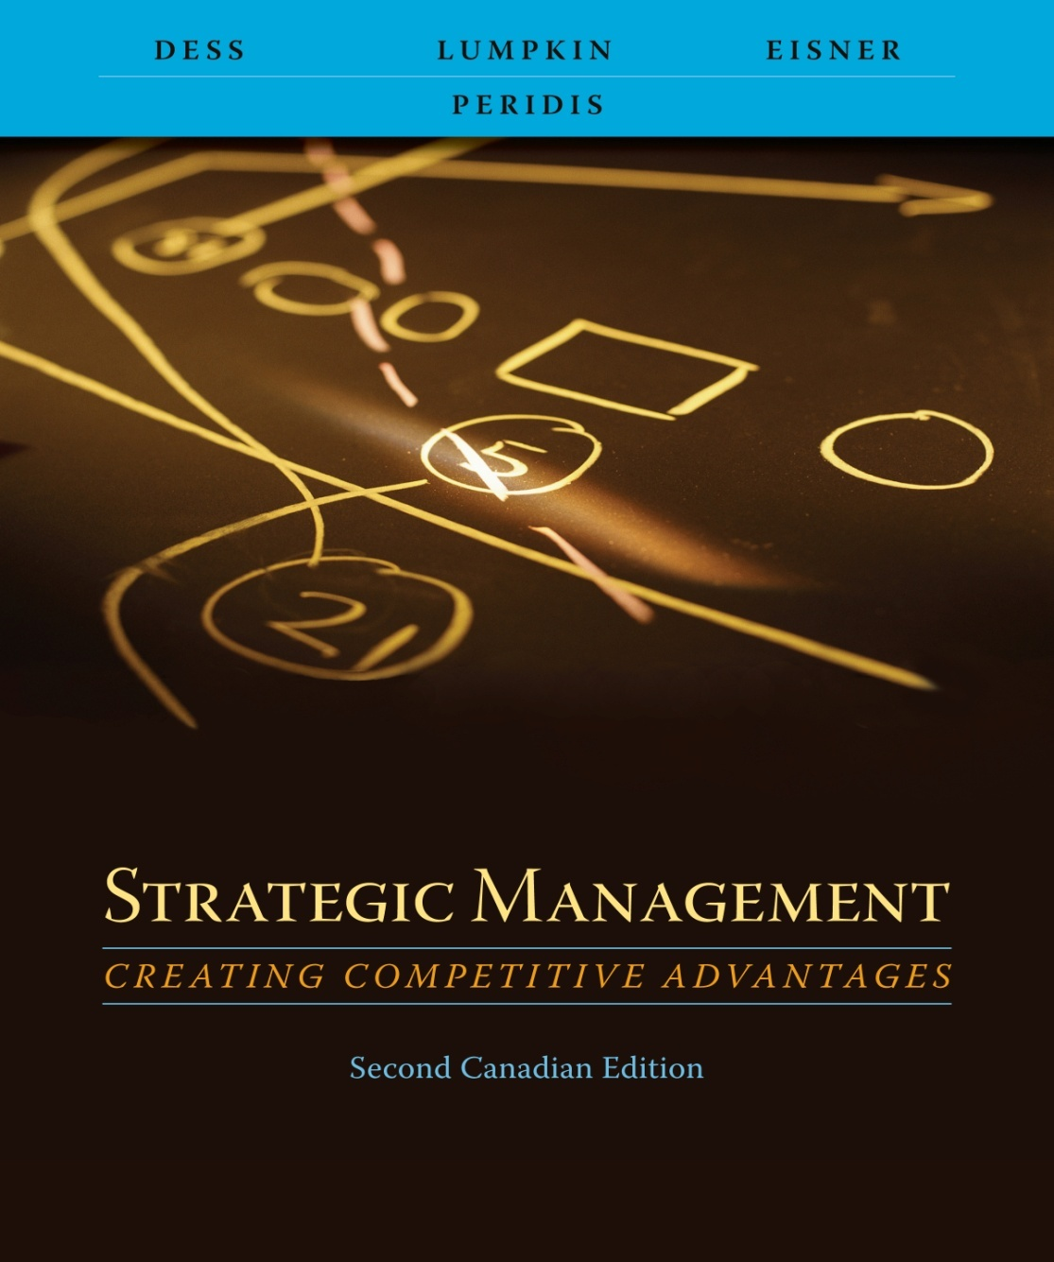
Chapter 10
Strategic Control and Corporate Governance

Slide 2
Learning Objectives
After reading this chapter, you should have a good understanding of:
  The value of effective strategic control systems in strategy implementation.
  The differences between financial and strategic controls and the role they play in the success of organizations.
  The benefits of having a proper balance among the three levers of behavioural control: culture, rewards and incentives, and boundaries.
  Why there is no “one best way” to design strategic control systems and how the most effective systems are contingent on situational factors and the organization’s specific strategic choices.
  5. The role of corporate governance mechanisms in ensuring that the interests of managers are aligned with those of shareholders.
Copyright © 2009 McGraw-Hill Ryerson Limited . 10-2

Slide 3



Feedback Control Systems
Traditional approach is sequential
  Strategies are formulated and top management sets goals
  Strategies are implemented
  Performance is measured against the predetermined goal set
  Control is based on a feedback loop from performance measurement to strategy formulation
Adapted from Exhibit 9.1 Traditional Approach to Strategic Control
Copyright © 2009 McGraw-Hill Ryerson Limited .10-3

Slide 4
Traditional Approach to Strategic Control
Process typically involves lengthy time lags, often tied to the annual planning cycle
This “single-loop” learning control system simply compares actual performance to a predetermined goal
Most appropriate when
  Environment is stable and relatively simple
  Goals and objectives can be measured with certainty
  Little need for complex measures of performance
Copyright © 2009 McGraw-Hill Ryerson Limited .10-4

Slide 5



Contemporary Approach to Strategic Control
Informational control
Behavioural control
Relationships between strategy formulation, implementation and control are highly interactive
Two different types of control
  Informational control
  Behavioural control
Adapted from Exhibit 9.2 Contemporary Approach to Strategic Control
Copyright © 2009 McGraw-Hill Ryerson Limited .10-5

Slide 6
Contemporary Approach to Strategic Control
Informational control
  Concerned with whether or not the organization is “doing the right things”
Behavioural control
  Concerned with whether or not the organization is “doing things right” in the implementation of its strategy
Both types of control are necessary conditions for success
Copyright © 2009 McGraw-Hill Ryerson Limited .10-6

Slide 7
Informational Control
Deals with internal environment and external strategic context
Key question
  “Do the organization’s goals and strategies still ‘fit’ within the context of the current strategic environment?”
Two key issues
  Scan and monitor external environment (general and industry)
  Continuously monitor the internal environment
Copyright © 2009 McGraw-Hill Ryerson Limited .10-7

Slide 8
Informational Control
Informational control requires four characteristics to be effective:
1. Focus on constantly changing information that top
managers identify as having potential strategic
importance.
2. The information is important enough to demand frequent
and regular attention from operating managers.
3. The data and information generated by the control system
are best interpreted and discussed in face-to-face
meetings among superiors and subordinates.
4. The control system is a key catalyst for an ongoing debate
about underlying data, assumptions, and action plans.
Copyright © 2009 McGraw-Hill Ryerson Limited .10-8

Slide 9

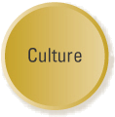
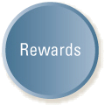
Behavioural Control: Balancing Culture, Rewards, and Boundaries
Behavioural control is focused on implementation—doing things right and is a balance between:
    Culture
    Rewards
    boundaries
Adapted from Exhibit 9.3 Essential Elements of Strategic Control
Copyright © 2009 McGraw-Hill Ryerson Limited .10-9

Slide 10
Building a Strong and Effective Culture
Organizational culture is a system of
  Shared values (what is important)
  Beliefs (how things work)
Organizational culture shapes a firm’s
  People
  Organizational structures
  Control systems
Organizational culture produces
  Behavioural norms (the way we do things around here)
Copyright © 2009 McGraw-Hill Ryerson Limited .10-10

Slide 11

Building a Strong and Effective Culture
Culture sets implicit boundaries (unwritten standards of acceptable behaviour)
  Dress
  Ethical matters
  The way an organization conducts its business
Culture acts as a means of reducing monitoring costs
Copyright © 2009 McGraw-Hill Ryerson Limited .10-11

Slide 12
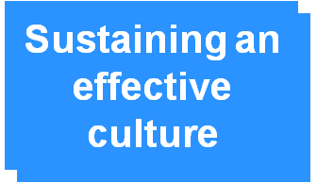
Building a Strong and Effective Culture
Effective culture must be
  Cultivated
  Encouraged
  Fertilized
Maintaining an effective culture
  Storytelling
  Rallies or pep talks by top executives
Copyright © 2009 McGraw-Hill Ryerson Limited .10-12

Slide 13
Motivating with Rewards and Incentives
Rewards and incentive systems
  Powerful means of influencing an organization’s culture
  Focuses efforts on high-priority tasks
  Motivates individual and collective task performance
  Can be an effective motivator and control mechanism
Copyright © 2009 McGraw-Hill Ryerson Limited .10-13

Slide 14
Motivating with Rewards and Incentives
Potential Downside
  Subcultures may arise in different business units with multiple reward systems
  May reflect differences among functional areas, products, services and divisions
  Shared values may emerge in subculture in opposition to patterns of the dominant culture
  Reward systems may lead to information hoarding, working at cross purposes
Copyright © 2009 McGraw-Hill Ryerson Limited .10-14

Slide 15
Motivating with Rewards and Incentives
Creating effective reward and incentive programs
  Objectives are clear, well understood and broadly accepted
  Rewards are clearly linked to performance and desired behaviours
  Performance measures are clear and highly visible
  Feedback is prompt, clear, and unambiguous
  Compensation “system” is perceived as fair and equitable
  Structure is flexible; it can adapt to changing circumstances
Copyright © 2009 McGraw-Hill Ryerson Limited .10-15

Slide 16
Setting Boundaries and Constraints
Focus efforts on strategic priorities
Short-term objectives
  Specific and measurable
  Specific time horizon for attainment
  Achievable, but challenging
  Provide proper direction, but be flexible when faced with need to change
Short-term action plans
  Specific
  Can be implemented
  Individual managers held accountable for implementation of action plans
Copyright © 2009 McGraw-Hill Ryerson Limited .10-16

Slide 17
Setting Boundaries and Constraints
Boundaries and constraints, when used properly.
Can serve purposes, including:
Focusing individual efforts on strategic partners
Providing short-term objectives and actions plans to channel efforts
Minimizing improper and unethical conduct
Copyright © 2009 McGraw-Hill Ryerson Limited .10-17

Slide 18
Organizational Control:
Alternative Approaches
Approach Some Situational Factors
Often found in professional organizations
Associated with high autonomy
Norms are the basis for behaviour
Culture: a system of unwritten rules that forms an internalized influence over behaviour.
Associated with standardized output
Tasks are generally repetitive and routine
Little need for innovation or creative activity
Rules: Written and explicit guidelines that provide external constraints on behaviour.
Adapted from Exhibit 9.5 Organizational Control: Alternative Approaches
Copyright © 2009 McGraw-Hill Ryerson Limited .10-18

Slide 19
Organizational Control:
Alternative Approaches
Approach Some Situational Factors
Rewards: The use of performance-based incentive systems to motivate.
Measurement of output and performance is rather straightforward
Most appropriate in organizations pursuing unrelated diversification strategies
Rewards may be used to reinforce other means of control
Adapted from Exhibit 9.5 Organizational Control: Alternative Approaches
Copyright © 2009 McGraw-Hill Ryerson Limited .10-19

Slide 20
Evolving from Boundaries to
Rewards and Culture
Organizations should strive to have boundaries internalized
  System of rewards and incentives coupled with a strong culture
    Hire the right people (already identify with the firm’s dominant values)
    Train people in the dominant cultural values
    Have managerial role models
    Reward systems clearly aligned with organizational goals and objectives
Copyright © 2009 McGraw-Hill Ryerson Limited .10-20

Slide 21

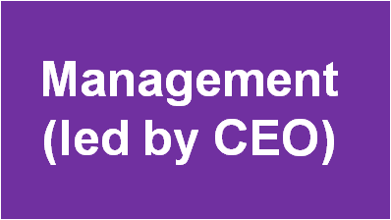

Role of Corporate Governance
Corporate governance
  Relationship among
    The shareholders
    The management (led by the Chief Executive Officer)
    The board of directors
Issue is
  How corporations can succeed (or fail) in aligning managerial motives with
    the interests of the shareholders
    The interests of the board of directors
Copyright © 2009 McGraw-Hill Ryerson Limited .10-21

Slide 22
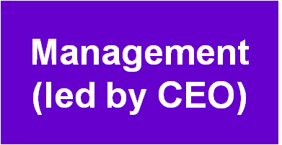
Separation of Owners (Shareholders) and Management
Shareholders
Owners
  Limited liability
  Participate in the profits of the enterprise
  Limited involvement in the company’s affairs
Management
  Run the company
  Does not personally have to provide the funds
Copyright © 2009 McGraw-Hill Ryerson Limited .10-21

Slide 23
Separation of Owners (Shareholders) and Management
Board of Directors
Board of directors
  Elected by shareholders
  Fiduciary obligation to protect shareholder interests
Copyright © 2009 McGraw-Hill Ryerson Limited .10-23

Slide 24
Agency Theory: Two Problems
Goals of principals and agents may conflict
  Difficulty or expensive for the principal to verify what the agent is actually doing
    Hard for board of directors to confirm that managers are actually acting in shareholders’ interests
    Managers may opportunistically pursue their own interests
Principal and agent may have different attitudes and preferences toward risk
Copyright © 2009 McGraw-Hill Ryerson Limited .10-24

Slide 25
Governance Mechanisms: Aligning the Interests of Owners and Managers
Two primary means of monitoring
behaviour of managers
  Committed and involved board of directors
    Active, critical participants in setting strategies
    Evaluate managers against high performance standards
    Take control of succession process
    Director independence
  Shareholder activism
    Right to sell stock
    Right to vote the proxy
    Right to sue for damages if directors or managers fail to meet their obligations
    Right to information from the company
    Residual rights following company’s liquidation
Copyright © 2009 McGraw-Hill Ryerson Limited .10-25

Slide 26
Governance Mechanisms: Aligning the Interests of Owners and Managers
Managerial incentives (contract-based outcomes)
  Reward and compensation agreements (from TIAA-CREF)
    Align rewards of all employees (including rank and file as well as executives) to the long-term performance of the corporation
    Allow creation of executive wealth that is reasonable in view of the creation of shareholder wealth
    Measurable and predictable outcomes that are directly linked to the company’s performance
    Market oriented
    Easy to understand by investors and employees
    Fully disclosed to investing public and approved by shareholders
Copyright © 2009 McGraw-Hill Ryerson Limited .10-26

Slide 27
External Governance
Control Mechanisms
Market for corporate control
Auditors
Banks and analysts
Regulatory bodies (Sarbanes-Oxley Act in 2002)
Media and public activists
Copyright © 2009 McGraw-Hill Ryerson Limited .10-27

Slide 28
Major Provisions of
Sarbanes-Oxley Act
Auditors
  Barred from certain types of non-audit work
  Not allowed to destroy records for five years
  Lead partners auditing a firm should be changed at least every five years
CEOs and CFOs
  Must fully reveal off-balance sheet finances
  Vouch for the accuracy of information revealed
Executives
  Must promptly reveal the sale of shares in firms they manage
  Are not allowed to sell shares when other employees cannot
Copyright © 2009 McGraw-Hill Ryerson Limited .10-28

